Slide 1
Embedding Ray Intersection Graphs and Global Curve Simplification
Mees van de Kerkhof, Irina Kostitsyna, Maarten Löffler
Notes:
Welcome to talk on <title>

Slide 2
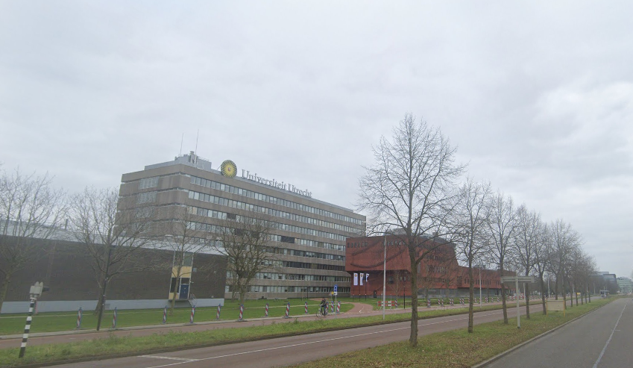
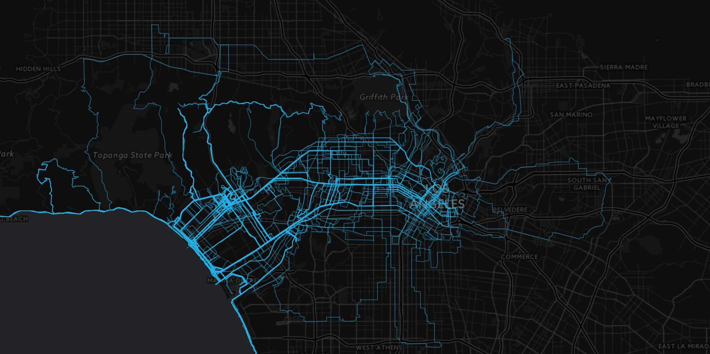
Who am I?
Notes:
Lets start by introducing myself, my name is Mees, I am a PhD student at UU, I am a computational geometer working on problems involving GPS trajectories, in particular on how they can be preprocessed. Which generally is quite unrelated to graph drawing. Which raises the question of..

Slide 3
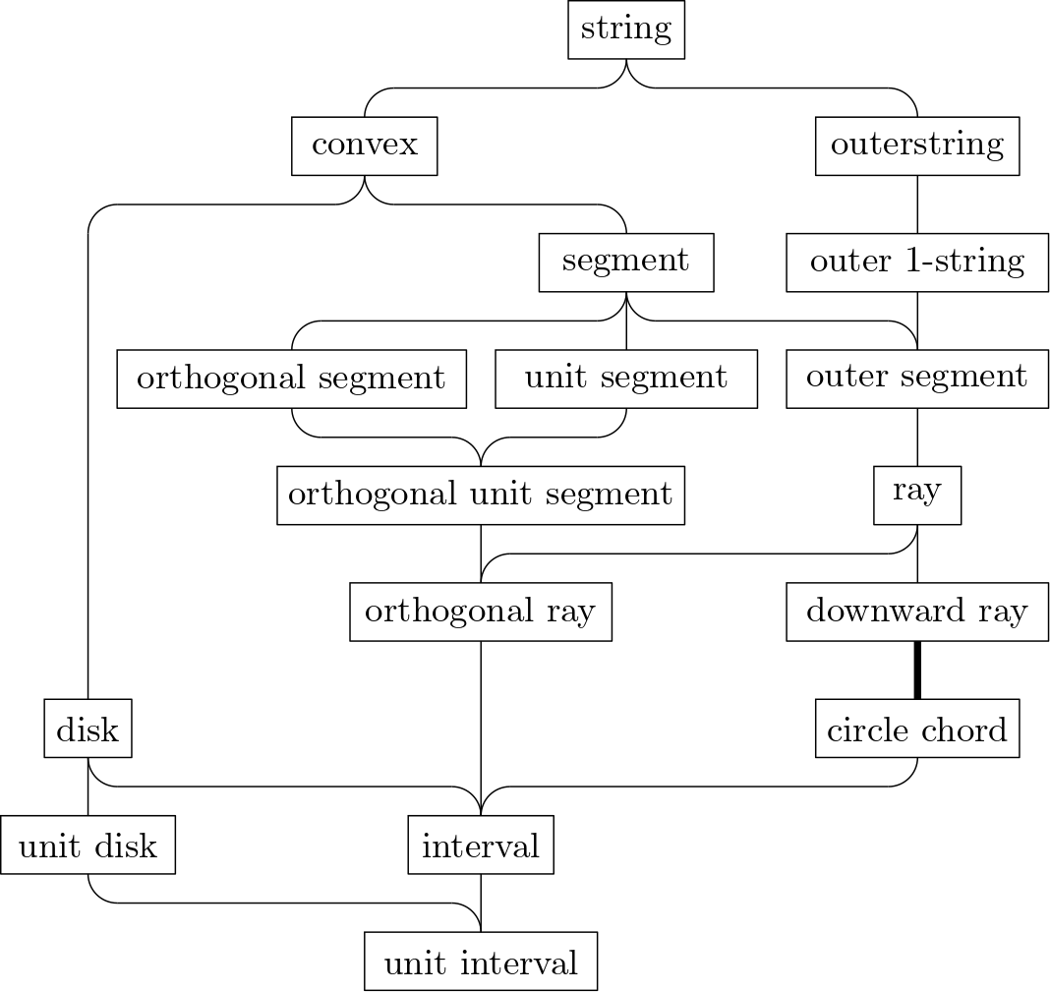
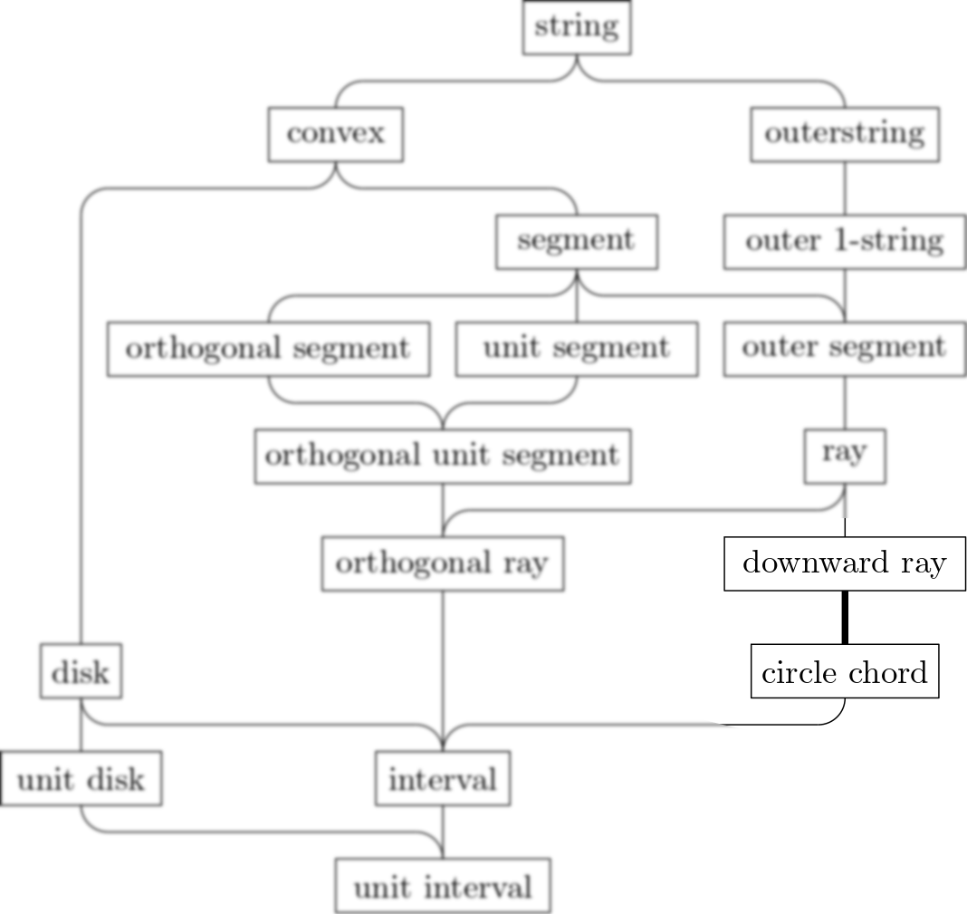
Why am I at GD?
Notes:
…why I am at this conference. The reason is twofold. Firstly, Tuebingen is a lovely city to visit, and after more than a year of lockdown it is nice to get out of the house. But more importantly, while solving a trajectory problem we incidentally ended up proving something that is revelvant for the GD community: a relation between graph classes. Specifically we show circle chord graphs are a subset of downward ray graphs.

Slide 4
Global Curve Simplification
Notes:
The problem we were studying is curve simplification. In this problem, we have a polygonal curve, and the question is if there exists a different polygonal curve with fewer vertices that still resembles the original

Slide 5
Global Curve Simplification (formal)
Given a polygonal curve P of n links, does there exist a polygonal curve P’ of at most k links such that D(P,P’) is at most $δ$.
There are no restrictions on where P’’s vertices can be placed.
In this specific case, we are trying to prove NP-hardness for this problem if D(P,P’) is the Hausdorff distance directed from P to P’.
Notes:
So formally, we are given a curve P of n links, and want to know if there exists a curve P’ that has at most k links where the distance between the curves is bound by a constant delta. If you are familiar with this problem you may know variants where the simplifications vertices are a subset of the original, but here the vertices for the simplification may be placed anywhere. There are then still more variants of this problem depending on how we measure the distance between the curves. In this specific case, we are looking at proving NP-hardness for when we measure distance as the directed hausdorf distance in the direction of original to simplification

Slide 6
Hausdorff Distance
$$\vec{H}\left(P,P^{′}\right)=\max_{p∈P}{\min_{q∈P′}\left\|p −q\right\|}$$
P’
P
Notes:
What this measure means is that if we have a curve and a simplification, the curve distance is the distance between the point on the original curve furthest from the simplification, to the closest point on the simplification.
This means that if the original curve is fully covered by the simplification, the distance is 0.

Slide 7
Connected Segment Polyline Cover
Given a set of segments whose union is connected, does there exist a polyline of at most k links that fully covers each segment?
Notes:
To prove NP-hardness we reduced from this problem: connected segment polyline cover. Here, we are given a set of line segments whose union is connected, and the question is if there exists a polyline of at most k links such that all segments are fully covered. The reduction works because we can turn the set of segments into a polyline with an identical union by picking a starting point and than traversing and double-backing over the segments. If we set delta to 0, a simplification must fully cover all segments of the polyline, so we know if we can find a simplification of k links, it is a polyline of k links that covers the original segments.
We are not done yet, because now we need to prove that connected segment polyine cover itself is actually NP-hard.

Slide 8
Connected Segment Polyline Cover
Given a set of segments whose union is connected, does there exist a polyline of at most k links that fully covers each segment?
Notes:
To prove NP-hardness we reduced from this problem: connected segment polyline cover. Here, we are given a set of line segments whose union is connected, and the question is if there exists a polyline of at most k links such that all segments are fully covered. The reduction works because we can turn the set of segments into a polyline with an identical union by picking a starting point and than traversing and double-backing over the segments. If we set delta to 0, a simplification must fully cover all segments of the polyline, so we know if we can find a simplification of k links, it is a polyline of k links that covers the original segments.
We are not done yet, because now we need to prove that connected segment polyine cover itself is actually NP-hard.

Slide 9
Connected Segment Polyline Cover
Given a set of segments whose union is connected, does there exist a polyline of at most k links that fully covers each segment?
Notes:
To prove NP-hardness we reduced from this problem: connected segment polyline cover. Here, we are given a set of line segments whose union is connected, and the question is if there exists a polyline of at most k links such that all segments are fully covered. The reduction works because we can turn the set of segments into a polyline with an identical union by picking a starting point and than traversing and double-backing over the segments. If we set delta to 0, a simplification must fully cover all segments of the polyline, so we know if we can find a simplification of k links, it is a polyline of k links that covers the original segments.
We are not done yet, because now we need to prove that connected segment polyine cover itself is actually NP-hard.

Slide 10
Hamiltonian Path on Ray Graphs
Notes:
We reduce from Hamiltonian Path on Ray graphs. So here we a graph represented by a set of n rays, starting at a point and going off to infinity in one direction. Each ray is a vertex and each ray intersection is an edge. and the question is if there is a path along the rays that traverses each ray exactly once.

Slide 11
Hamiltonian Path on Ray Graphs
Notes:
We reduce from Hamiltonian Path on Ray graphs. So here we a graph represented by a set of rays, starting at a point and going off to infinity in one direction. Each ray is a vertex and each ray intersection is an edge. and the question is if there is a path along the rays that traverses each ray exactly once.

Slide 12
Sketch for the proof
Notes:
We will transform this by looking at the supporting lines of the rays, particularly the half that doesnt have the ray itself. We will choose a circle that is big enough to contain all of the intersections between these half-lines, and then cut the lines into segments with this circle. We then replace these segments by pairs of segments, where each pair meets at a point on the circle, and has their other endpoint very close to the starting point of the ray, making it run near-parallel to the ray. This gives us 2n segments. We know that if we want to find a polyline of length 2n that each link must fully cover one segment. This means that the polyline can only bend at the common endpoint of the segments or on intersection points of the supporting lines of the segments that lie extremely close to intersection points of the rays. And so a polyline covering all the segments must correspond to a hamiltonian path on the rays.

Slide 13
Sketch for the proof
Notes:
We will transform this by looking at the supporting lines of the rays, particularly the half that doesnt have the ray itself. We will choose a circle that is big enough to contain all of the intersections between these half-lines, and then cut the lines into segments with this circle. We then replace these segments by pairs of segments, where each pair meets at a point on the circle, and has their other endpoint very close to the starting point of the ray, making it run near-parallel to the ray. This gives us 2n segments. We know that if we want to find a polyline of length 2n that each link must fully cover one segment. This means that the polyline can only bend at the common endpoint of the segments or on intersection points of the supporting lines of the segments that lie extremely close to intersection points of the rays. And so a polyline covering all the segments must correspond to a hamiltonian path on the rays.

Slide 14
Sketch for the proof
Notes:
We will transform this by looking at the supporting lines of the rays, particularly the half that doesnt have the ray itself. We will choose a circle that is big enough to contain all of the intersections between these half-lines, and then cut the lines into segments with this circle. We then replace these segments by pairs of segments, where each pair meets at a point on the circle, and has their other endpoint very close to the starting point of the ray, making it run near-parallel to the ray. This gives us 2n segments. We know that if we want to find a polyline of length 2n that each link must fully cover one segment. This means that the polyline can only bend at the common endpoint of the segments or on intersection points of the supporting lines of the segments that lie extremely close to intersection points of the rays. And so a polyline covering all the segments must correspond to a hamiltonian path on the rays.

Slide 15
Sketch for the proof
Notes:
We will transform this by looking at the supporting lines of the rays, particularly the half that doesnt have the ray itself. We will choose a circle that is big enough to contain all of the intersections between these half-lines, and then cut the lines into segments with this circle. We then replace these segments by pairs of segments, where each pair meets at a point on the circle, and has their other endpoint very close to the starting point of the ray, making it run near-parallel to the ray. This gives us 2n segments. We know that if we want to find a polyline of length 2n that each link must fully cover one segment. This means that the polyline can only bend at the common endpoint of the segments or on intersection points of the supporting lines of the segments that lie extremely close to intersection points of the rays. And so a polyline covering all the segments must correspond to a hamiltonian path on the rays.

Slide 16
Sketch for the proof
2n segments
Polyline of 2n links
Notes:
We will transform this by looking at the supporting lines of the rays, particularly the half that doesnt have the ray itself. We will choose a circle that is big enough to contain all of the intersections between these half-lines, and then cut the lines into segments with this circle. We then replace these segments by pairs of segments, where each pair meets at a point on the circle, and has their other endpoint very close to the starting point of the ray, making it run near-parallel to the ray. This gives us 2n segments. We know that if we want to find a polyline of length 2n that each link must fully cover one segment. This means that the polyline can only bend at the common endpoint of the segments or on intersection points of the supporting lines of the segments that lie extremely close to intersection points of the rays. And so a polyline covering all the segments must correspond to a hamiltonian path on the rays.

Slide 17
Sketch for the proof
2n segments
Polyline of 2n links
Notes:
We will transform this by looking at the supporting lines of the rays, particularly the half that doesnt have the ray itself. We will choose a circle that is big enough to contain all of the intersections between these half-lines, and then cut the lines into segments with this circle. We then replace these segments by pairs of segments, where each pair meets at a point on the circle, and has their other endpoint very close to the starting point of the ray, making it run near-parallel to the ray. This gives us 2n segments. We know that if we want to find a polyline of length 2n that each link must fully cover one segment. This means that the polyline can only bend at the common endpoint of the segments or on intersection points of the supporting lines of the segments that lie extremely close to intersection points of the rays. And so a polyline covering all the segments must correspond to a hamiltonian path on the rays.

Slide 18
Sketch for the proof
Notes:
We will transform this by looking at the supporting lines of the rays, particularly the half that doesnt have the ray itself. We will choose a circle that is big enough to contain all of the intersections between these half-lines, and then cut the lines into segments with this circle. We then replace these segments by pairs of segments, where each pair meets at a point on the circle, and has their other endpoint very close to the starting point of the ray, making it run near-parallel to the ray. This gives us 2n segments. We know that if we want to find a polyline of length 2n that each link must fully cover one segment. This means that the polyline can only bend at the common endpoint of the segments or on intersection points of the supporting lines of the segments that lie extremely close to intersection points of the rays. And so a polyline covering all the segments must correspond to a hamiltonian path on the rays.

Slide 19
Hamiltonian Path on Ray Graphs
Notes:
We will transform this by looking at the supporting lines of the rays, particularly the half that doesnt have the ray itself. We will choose a circle that is big enough to contain all of the intersections between these half-lines, and then cut the lines into segments with this circle. We then replace these segments by pairs of segments, where each pair meets at a point on the circle, and has their other endpoint very close to the starting point of the ray, making it run near-parallel to the ray. This gives us 2n segments. We know that if we want to find a polyline of length 2n that each link must fully cover one segment. This means that the polyline can only bend at the common endpoint of the segments or on intersection points of the supporting lines of the segments that lie extremely close to intersection points of the rays. And so a polyline covering all the segments must correspond to a hamiltonian path on the rays.

Slide 20
Ray graph troubles
The segments do not form a connected union
Proof for hardness of Hamiltonian Path on ray graphs is missing
Recognizing a ray graph is ETR-hard
This implies that there are ray graphs that cannot be represented as rays using subexponential complexity
Notes:
There are some problems with this sketch. The segments are not connected, we must still show NP-hardness for HP on ray graphs, and there is a problem that recognizing a ray graph is hard for the ETR, which implies there must be some ray graphs that cannot be represented as a set of rays without requiring exponential bit complexity. We will resolve all of these problems by considering a different class of graphs…

Slide 21
Circle Chord graphs
Hamiltonian path on circle chord graphs is known to be hard (Damaschke 1989)
We will show that Circle Chord graphs are Ray graphs that can be represented with polynomial bit complexity.
Notes:
Circle chord graphs, where we can represent the graph with one chord on a circle for every vertex and an intersection for each edge. There is a proof available for HP on these graphs. And we will now show how each circle chord graph can be represented as a set of intersecting rays with polynomial bit complexity.

Slide 22
Constructing points
Points for x=1, x=2, …. x=2n
$p_{1}=\left(1,1!\right), p_{2}=\left(2,2!\right)$…
No ray intersections below
the curve
$$f\left(x\right)=x!$$
Notes:
To do this, we need to construct a set of points we will be using for our rays, which lie on a rapidly increasing function. We use the factorial function for this. (very roughly sketched here as otherwise barely any points fit on the slide. We will construct rays that each start at one of these points and will intersect the curve at another point. Because the function grows so rapidly, we now know that no two rays will intersect below the curve…

Slide 23
Unrolling a circle graph
Notes:
Now that we know the rays won’t intersect below the curve, we can unroll a circle graph, by picking one chord endpoint to be the starting point and then going over the chord endpoints on the circle in order. For each new endpoint we find we assign one point on the curve. If a chord gets a second point assigned we construct the ray. In the end we will have rays with the same intersections as the chords. It is like taking some scissors and cutting the circle open, and then pulling the circle ends apart so it becomes a curve going upwards instead. So we have transformed the circle chord graph to a downwards ray graph.

Slide 24
Constructing segments
Notes:
From a set of constructed rays like these, we can now construct segments again. Instead of a circle we now use a line that lies below all intersections between ray supporting lines (there arent any here because otherwise the line wouldn’t fit on the slide.) We create segments for each ray, but now additionaly we add three more segments, so that all of the segments together have a connected union. We now have 2n+3 segments total. A polyline of 2n+3 links covering all segments must start by covering the three additional segments, and can then only bend at the shared endpoints of segments, or at intersection points of supporting lines of segments, that lie extremely close to intersection points of the rays. And so a polyline covering all of the segments must correspond to a hamiltonian path on the rays and thus the original chords. This finally concludes are chain of proofs…

Slide 25
Constructing segments
Notes:
From a set of constructed rays like these, we can now construct segments again. Instead of a circle we now use a line that lies below all intersections between ray supporting lines (there arent any here because otherwise the line wouldn’t fit on the slide.) We create segments for each ray, but now additionaly we add three more segments, so that all of the segments together have a connected union. We now have 2n+3 segments total. A polyline of 2n+3 links covering all segments must start by covering the three additional segments, and can then only bend at the shared endpoints of segments, or at intersection points of supporting lines of segments, that lie extremely close to intersection points of the rays. And so a polyline covering all of the segments must correspond to a hamiltonian path on the rays and thus the original chords. This finally concludes are chain of proofs…

Slide 26
Finding a polyline
Notes:
From a set of constructed rays like these, we can now construct segments again. Instead of a circle we now use a line that lies below all intersections between ray supporting lines (there arent any here because otherwise the line wouldn’t fit on the slide.) We create segments for each ray, but now additionaly we add three more segments, so that all of the segments together have a connected union. We now have 2n+3 segments total. A polyline of 2n+3 links covering all segments must start by covering the three additional segments, and can then only bend at the shared endpoints of segments, or at intersection points of supporting lines of segments, that lie extremely close to intersection points of the rays. And so a polyline covering all of the segments must correspond to a hamiltonian path on the rays and thus the original chords. This finally concludes are chain of proofs…

Slide 27
Conclusions
We have proven the NP-hardness of Global Curve Simplification using the Hausdorff distance directed from P to P’
We have shown that each circle chord graph is a ray graph that can be represented using polynomial bit complexity
In the paper, we also extend the hardness proof to cases where $δ>0$
Notes:
Which means that we can conclude that we have shown NP-hardness of Global Curve Simplification when using the Hausdorff distance directed from original to simplification. In the process, we have shown that each circle chord graph is a ray graph that can be represented using polynomial bit complexity. The proof here uses delta equals zero for the curve simplification, but in the paper we also extend this to a non-zero delta.
Thank you for your attention.

Slide 28
Bonus slide: Case distinction
Notes:
We can see this by case distinction. If we consider two rays, there are three cases depending on if the second ray starts and ends before the point where the first ray intersects the curve. If the second ray starts above the first curves intersection point, it will also have higher slope and thus not intersect it. If the ray starts before the intersection point but ends after it, the rays will intersect above the curve. If the second ray has both of its points below the upper intersection point of the first ray, the first ray will have a higher slope, and thus they wont intersect below the curve. Note that for the first two cases any function with an accelelerating rate of growth, but for the third case for the first ray to have higher slope the function we use to generate points has to grow at least as fast as the factorial function…

Slide 29
Constructing segments
Notes:
From a set of constructed rays like these, we can now construct segments again. Instead of a circle we now use a line that lies below all intersections between ray supporting lines (there arent any here because otherwise the line wouldn’t fit on the slide.) We create segments for each ray, but now additionaly we add three more segments, so that all of the segments together have a connected union. We now have 2n+3 segments total. A polyline of 2n+3 links covering all segments must start by covering the three additional segments, and can then only bend at the shared endpoints of segments, or at intersection points of supporting lines of segments, that lie extremely close to intersection points of the rays. And so a polyline covering all of the segments must correspond to a hamiltonian path on the rays and thus the original chords. This finally concludes are chain of proofs…

Slide 30
Constructing segments
Notes:
From a set of constructed rays like these, we can now construct segments again. Instead of a circle we now use a line that lies below all intersections between ray supporting lines (there arent any here because otherwise the line wouldn’t fit on the slide.) We create segments for each ray, but now additionaly we add three more segments, so that all of the segments together have a connected union. We now have 2n+3 segments total. A polyline of 2n+3 links covering all segments must start by covering the three additional segments, and can then only bend at the shared endpoints of segments, or at intersection points of supporting lines of segments, that lie extremely close to intersection points of the rays. And so a polyline covering all of the segments must correspond to a hamiltonian path on the rays and thus the original chords. This finally concludes are chain of proofs…

Slide 31
Constructing segments
Notes:
From a set of constructed rays like these, we can now construct segments again. Instead of a circle we now use a line that lies below all intersections between ray supporting lines (there arent any here because otherwise the line wouldn’t fit on the slide.) We create segments for each ray, but now additionaly we add three more segments, so that all of the segments together have a connected union. We now have 2n+3 segments total. A polyline of 2n+3 links covering all segments must start by covering the three additional segments, and can then only bend at the shared endpoints of segments, or at intersection points of supporting lines of segments, that lie extremely close to intersection points of the rays. And so a polyline covering all of the segments must correspond to a hamiltonian path on the rays and thus the original chords. This finally concludes are chain of proofs…

Slide 32
Constructing segments
Notes:
From a set of constructed rays like these, we can now construct segments again. Instead of a circle we now use a line that lies below all intersections between ray supporting lines (there arent any here because otherwise the line wouldn’t fit on the slide.) We create segments for each ray, but now additionaly we add three more segments, so that all of the segments together have a connected union. We now have 2n+3 segments total. A polyline of 2n+3 links covering all segments must start by covering the three additional segments, and can then only bend at the shared endpoints of segments, or at intersection points of supporting lines of segments, that lie extremely close to intersection points of the rays. And so a polyline covering all of the segments must correspond to a hamiltonian path on the rays and thus the original chords. This finally concludes are chain of proofs…

Slide 33
Constructing segments
Notes:
From a set of constructed rays like these, we can now construct segments again. Instead of a circle we now use a line that lies below all intersections between ray supporting lines (there arent any here because otherwise the line wouldn’t fit on the slide.) We create segments for each ray, but now additionaly we add three more segments, so that all of the segments together have a connected union. We now have 2n+3 segments total. A polyline of 2n+3 links covering all segments must start by covering the three additional segments, and can then only bend at the shared endpoints of segments, or at intersection points of supporting lines of segments, that lie extremely close to intersection points of the rays. And so a polyline covering all of the segments must correspond to a hamiltonian path on the rays and thus the original chords. This finally concludes are chain of proofs…

Slide 34
Constructing segments
Notes:
From a set of constructed rays like these, we can now construct segments again. Instead of a circle we now use a line that lies below all intersections between ray supporting lines (there arent any here because otherwise the line wouldn’t fit on the slide.) We create segments for each ray, but now additionaly we add three more segments, so that all of the segments together have a connected union. We now have 2n+3 segments total. A polyline of 2n+3 links covering all segments must start by covering the three additional segments, and can then only bend at the shared endpoints of segments, or at intersection points of supporting lines of segments, that lie extremely close to intersection points of the rays. And so a polyline covering all of the segments must correspond to a hamiltonian path on the rays and thus the original chords. This finally concludes are chain of proofs…

Slide 35
Finding a polyline
Notes:
From a set of constructed rays like these, we can now construct segments again. Instead of a circle we now use a line that lies below all intersections between ray supporting lines (there arent any here because otherwise the line wouldn’t fit on the slide.) We create segments for each ray, but now additionaly we add three more segments, so that all of the segments together have a connected union. We now have 2n+3 segments total. A polyline of 2n+3 links covering all segments must start by covering the three additional segments, and can then only bend at the shared endpoints of segments, or at intersection points of supporting lines of segments, that lie extremely close to intersection points of the rays. And so a polyline covering all of the segments must correspond to a hamiltonian path on the rays and thus the original chords. This finally concludes are chain of proofs…

Slide 36
Finding a polyline
Notes:
From a set of constructed rays like these, we can now construct segments again. Instead of a circle we now use a line that lies below all intersections between ray supporting lines (there arent any here because otherwise the line wouldn’t fit on the slide.) We create segments for each ray, but now additionaly we add three more segments, so that all of the segments together have a connected union. We now have 2n+3 segments total. A polyline of 2n+3 links covering all segments must start by covering the three additional segments, and can then only bend at the shared endpoints of segments, or at intersection points of supporting lines of segments, that lie extremely close to intersection points of the rays. And so a polyline covering all of the segments must correspond to a hamiltonian path on the rays and thus the original chords. This finally concludes are chain of proofs…

Slide 37
Finding a polyline
Notes:
From a set of constructed rays like these, we can now construct segments again. Instead of a circle we now use a line that lies below all intersections between ray supporting lines (there arent any here because otherwise the line wouldn’t fit on the slide.) We create segments for each ray, but now additionaly we add three more segments, so that all of the segments together have a connected union. We now have 2n+3 segments total. A polyline of 2n+3 links covering all segments must start by covering the three additional segments, and can then only bend at the shared endpoints of segments, or at intersection points of supporting lines of segments, that lie extremely close to intersection points of the rays. And so a polyline covering all of the segments must correspond to a hamiltonian path on the rays and thus the original chords. This finally concludes are chain of proofs…

